Slide 1




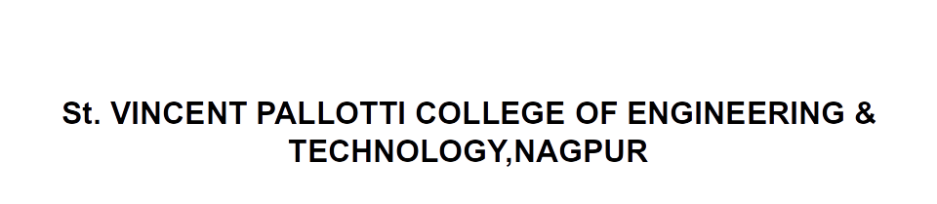
Open Elective –III Transportation System
CV705T

Slide 2

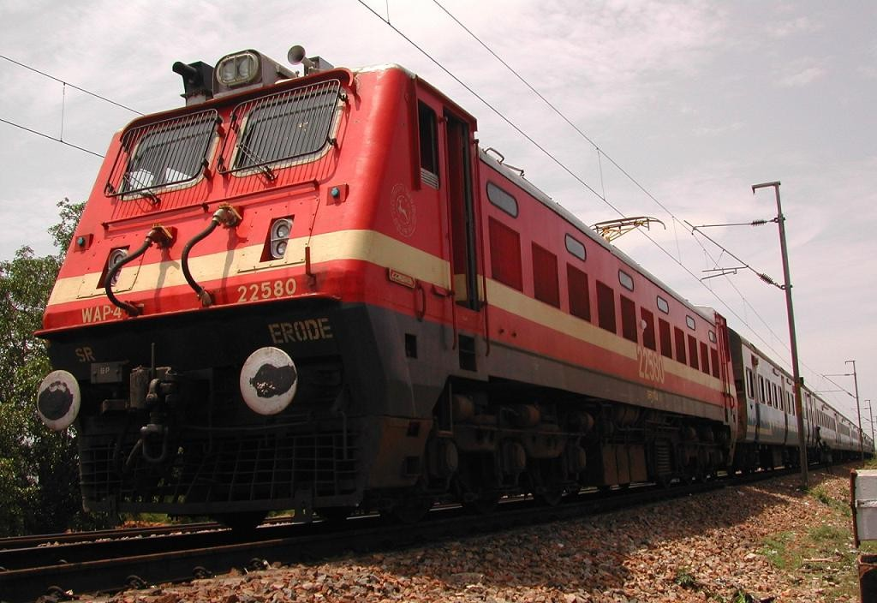

Slide 3
Unit II
Railway Systems: Railway components, geometrics, hauling capacity of a locomotive, stations and yards, signalling.

Slide 4
History of Indian Railways
In the year 1832 the first Railway running on steam engine, was launched in England. Thereafter on 1st of August, 1849 the Great Indian Peninsular Railways Company was established in India.
On 17th of August 1849, a contract was signed between the Great Indian Peninsular Railways Company and East India Company.
As a result of the contract an experiment was made by laying a railway track between Bombay and Thane (56 Kms).

Slide 5
Continues…..
On 16th April, 1853, the first train service was started from Bombay to Thane.
On 15th August, 1854, the 2nd train service commenced between Howrah and Hubli.
On the 1st July, 1856, the 3rd train service in India and first in South India commenced between Vyasarpadi and Walajah Road and on the same day the section between Vyasarpadi and Royapuram by Madras Railway Company was also opened

Slide 6
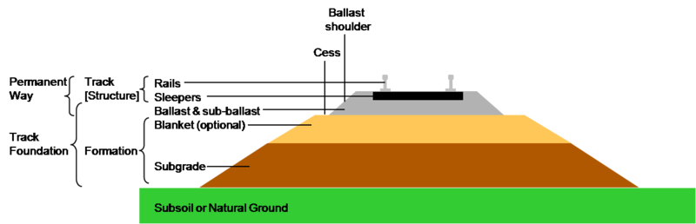
Elements of Railway tracks
The track on a railway or railroad, also known as the permanent way, is the structure consisting of the rails, fasteners, sleepers and ballast (or slab track), plus the underlying sub grade.
For clarity it is often referred to as railway track or railroad track.

Slide 7
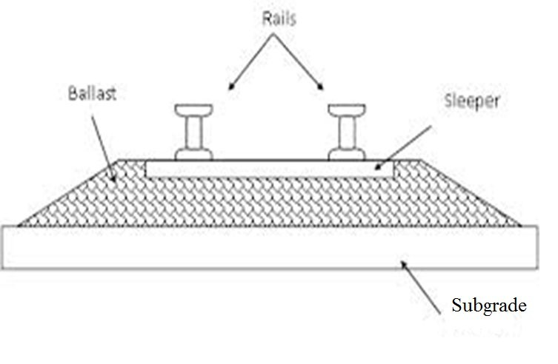
RAILWAY TRACK
COMPONENT PARTS OF A RAILWAY TRACK

Slide 8
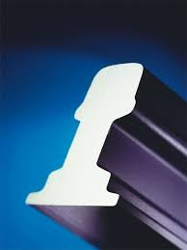
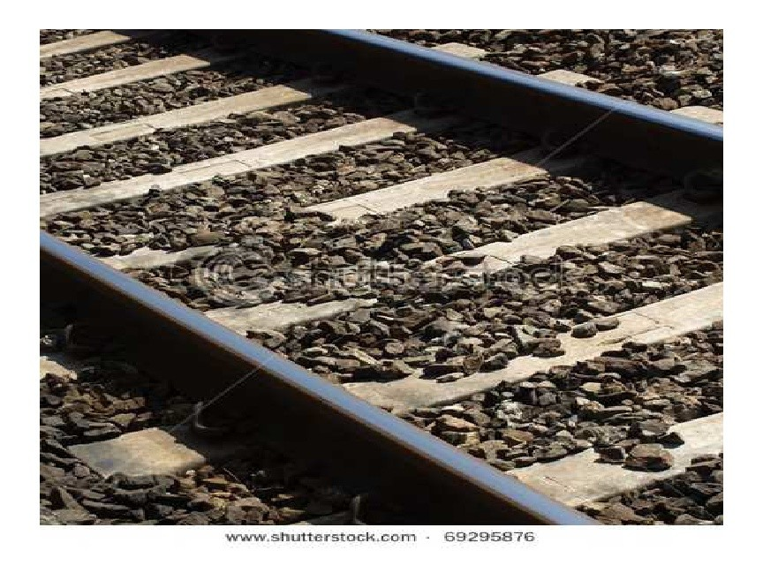
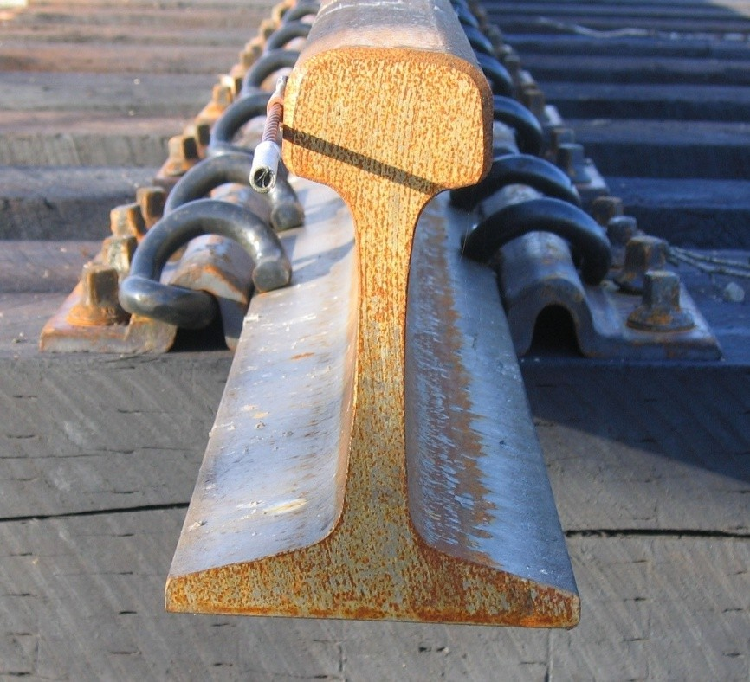
RAILS

Slide 9
RAILS
Can be considered as steel girders for the purpose of carrying loads
Made up of high carbon steel to withstand wear and tear
Flat footed rails are mostly used in railway track

Slide 10
FUNCTIONS OF RAILS
Rails provide hard, smooth and unchanging surface for passage of heavy moving loads with minimum friction between steel rail and steel wheel
Rails bear the stresses developed due to heavy vertical loads, lateral and braking forces and thermal stresses
The rail material used is such that it gives minimum wear to avoid replacement charges and failure due to wear
Rails transmit the loads to sleepers and consequently reduce pressure on ballast and formation below

Slide 11
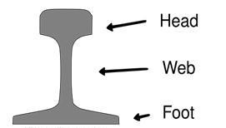
REQUIREMENTS OF RAILS
Rails should be designed for optimum nominal weight to provide for the most efficient distribution of metal in its various components

Slide 12
REQUIREMENTS (cntd..)
The vertical stiffness should be high enough to transmit load to sleepers. The height of the rail should be adequate
Rails should be capable of withstanding lateral forces. Large width of head and foot provides the rail with high lateral stiffness
The depth of head of rail should be sufficient to allow for adequate margin of vertical wear. The wearing surface should be hard
The web of rails should be sufficiently thick to bear the load coming to it and should provide adequate flexural rigidity in horizontal plane

Slide 13
REQUIREMENTS (cntd..)
Foot should be wide enough so that the rails are stable against overturning especially on curves
Bottom of the head and top of foot should be so as to enable the fish plates to transmit the vertical load efficiently from the head to the foot at rail joint
The centre of gravity of rail section must lie approximately at mid height so that maximum tensile and compressive stresses are equal

Slide 14
REQUIREMENTS (cntd..)
Tensile strength of rail shouldn’t be less than 72 kg/m²
To bring down the contact stresses to minimum level, the contact area between the rail and wheel should be as large as possible

Slide 15
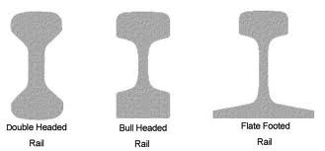
TYPES OF RAIL SECTIONS
Double headed rails
Bull headed rails
Flat footed rails

Slide 16
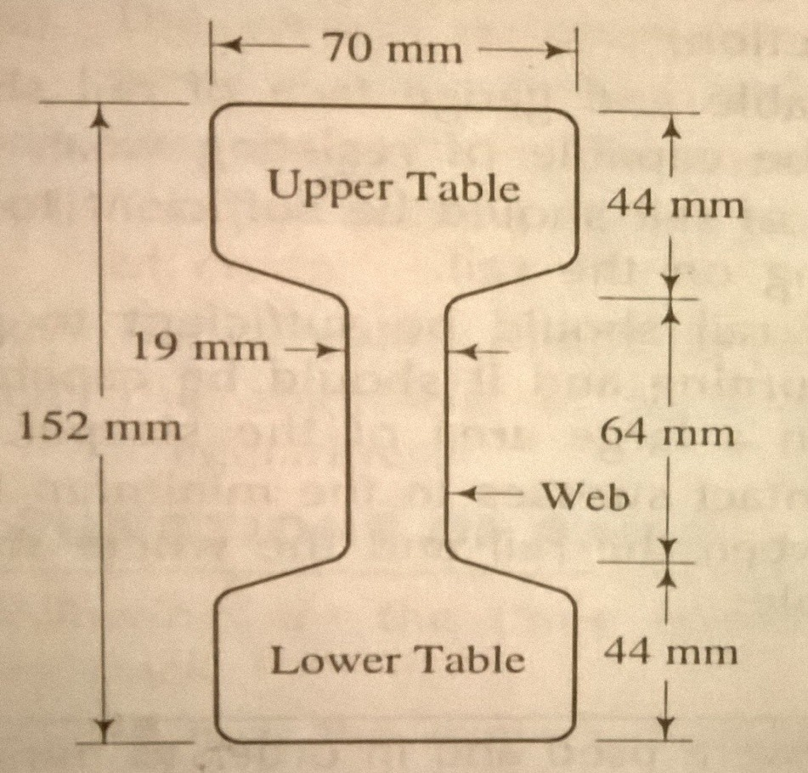
DOUBLE HEADED RAILS
First stage of development of rails
3 parts:
Upper table
Web
Lower table
Similar to dumb bell section
Both upper and lower tables are identical
When upper table was worn out, the rail can be reversed thus lower table can be brought into use
Practically out of use
Made of wrought iron
Length varying from 610 cm to 732 cm

Slide 17
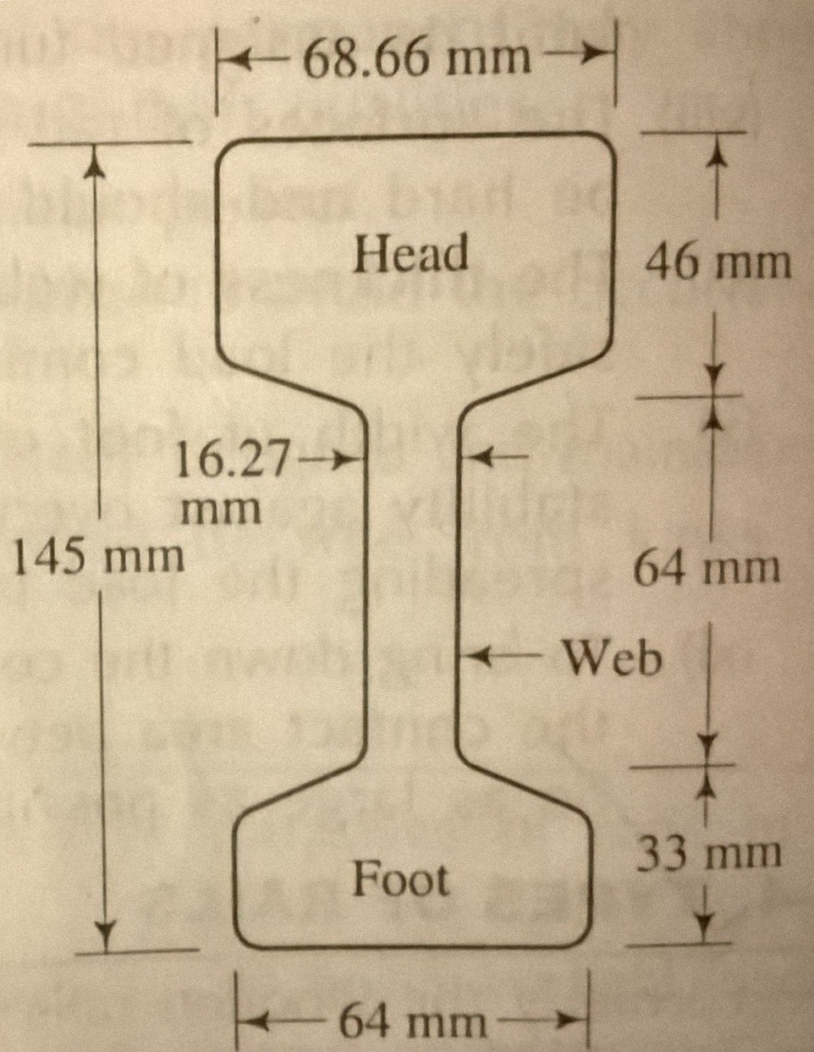
BULL HEADED RAIL
Made up of steel
Head is larger than foot
Foot is designed only to hold the wooden keys with which rails are secured to chairs
Extensively used in England
Weight of standard rail or British rail is 47 kg/m of length for main lines and 42 kg/m length on branch lines
Length of rail usually 18.29 m

Slide 18
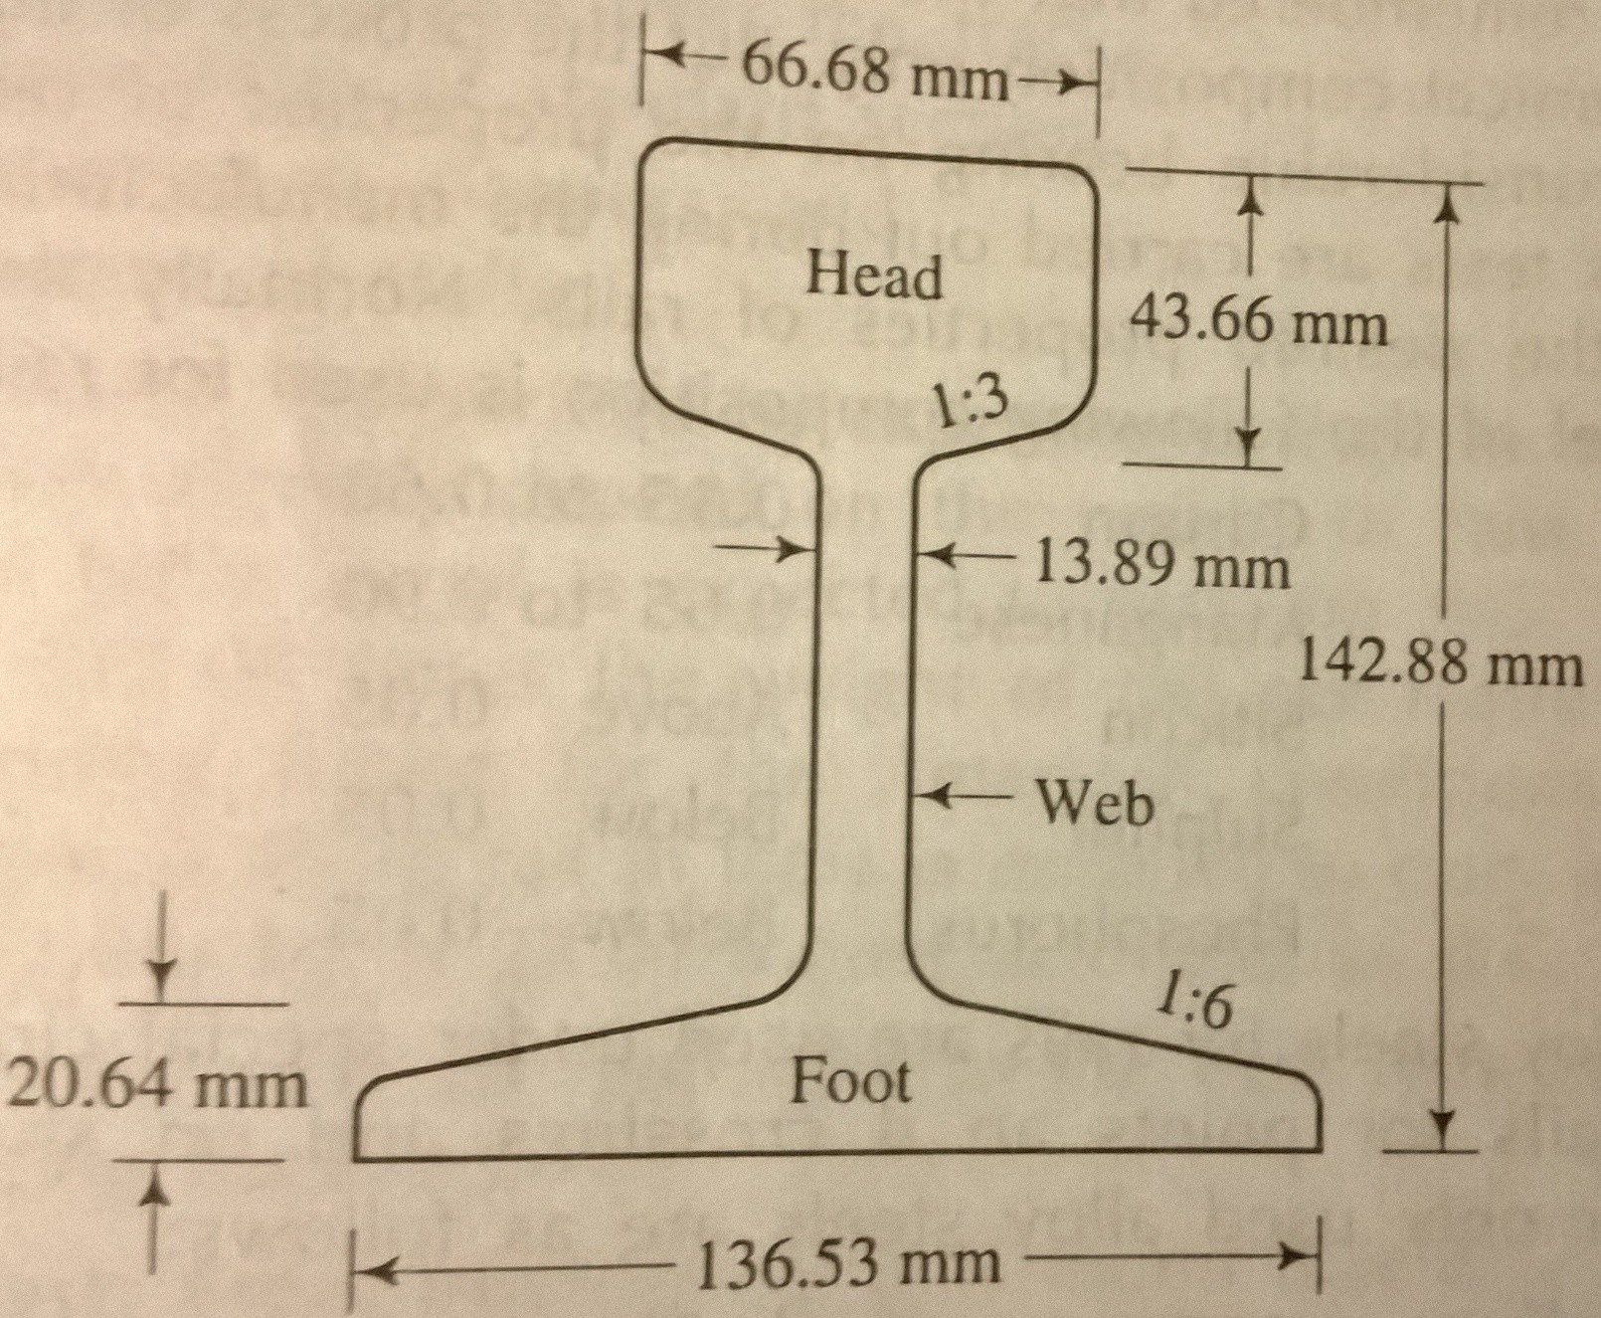
FLAT FOOTED RAIL
Foot is spread out to form a base
Invented by Charles Vignoles in 1836 and hence also known as “Vignoles Rails”
90 % of railway track is made up of flat footed rails

Slide 19
Advantages of flat footed rails
Chairs
No chairs are required
Foot of rail directly spiked to sleepers
Kinks
Less liable to develop kinks and maintains regular top surface than BHR
Cost
Cheaper
Load distribution
Distributes loads over large area
Results great track stability, longer life of rails and sleepers, reduced maintenance cost, less rail failures and few interruptions to traffic

Slide 20


